Slide 1


CSM Engagement
CSM
AWARENESS
CSM
POSITIONING
CSM
ENGAGEMENT
Goal: Engage with customers maximizing business impact out of co-innovation and Cloud Paks deployments
Outcome:
Alignment with customer/partners on CSM scope of engagement activities
High Level engagement plan
CSM transition & onboarding - teaming up in governance and projects meetings, access to systems
Prerequisites: “Be ready to engage – bring everyone on the same page, sharing common vision”
Gather information about customer’s current situation, pain points (connecting to account teams, partners, knowing about history, inputs from customer created/escalated cases ,….)
Understand the scope of CSM deployment activities (ref. to entitlements) and opportunities for expansion
This template helps to engage as a CSM with your customer
IBM Customer Success / © 2022 IBM Corporation

Slide 2
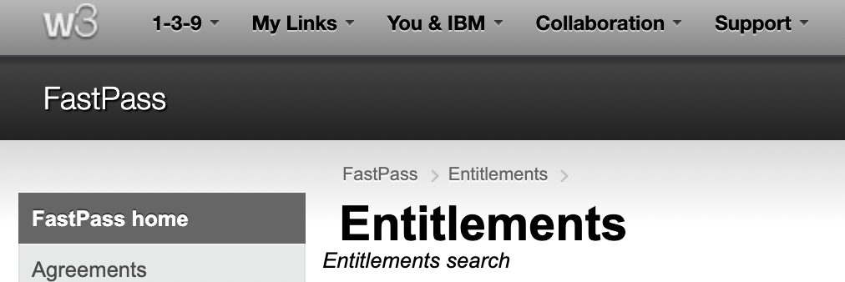

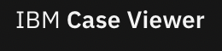
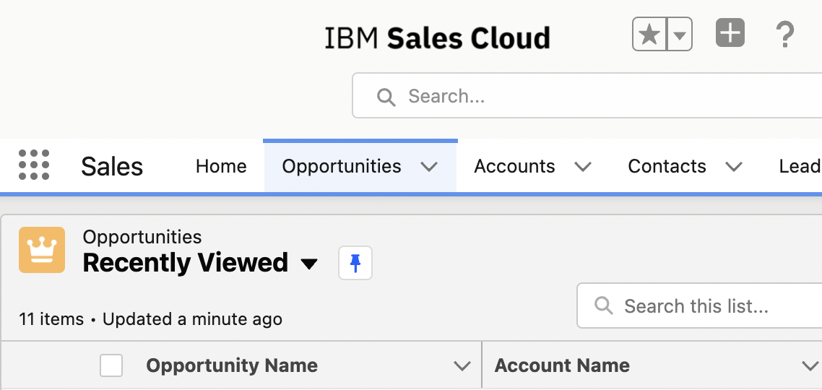

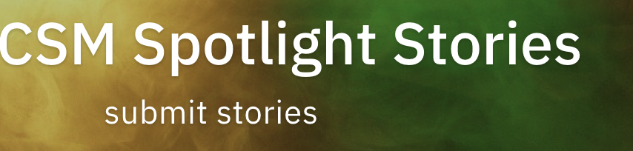

CSM Engagement Enablers
CSM
AWARENESS
CSM
POSITIONING
CSM
ENGAGEMENT
Prerequisites: “Be ready to engage”
Gather customer’s information: strategy, ecosystem, hybrid cloud journey, architecture, technologies,…
Get insights into current program and initiatives – leveraging on account team & ecosystem
Understand their entitlements, their reality: current support needs/ operational challenges and opportunities for expansion
Guided procedures for CSM Onboarding via CSM Playbook
Customer Entitlements via FastPass (feeding Gainsight)
Cases / Issues overview via Case Viewer, End of Support products
Opportunities via IBM Sales Cloud
Customer Success Stories , CSM Use Cases resonance with Customer’s one
Dedicated CSM Spotlight Stories in resonance with Customer’s one
More info on CSM Tools of the Trade
All what you need to know to and access via CSM ToolKit
This template helps to engage as a CSM with your customer
IBM Customer Success / © 2022 IBM Corporation

Slide 3


Customer
Logo
Welcome to
IBM Customer Success
High Level Engagement Plan
Date: dd/mm/yy
Location: XYZ, Country

Slide 4

Customer
Logo
Customer Success Engagement | Meeting Agenda (45min)
Topics | Comments | Participants | Duration
Introduction | Getting together |  | 5 Mins
Updates on business strategy & objectives Current situation Business challenges and needs | Customer |  | 10 min
Quick recap & validation : current initiatives and goals, entitlement overview and uses case deployment status High Level Roadmap Proposal+ enablement plan Customer Success Engagement Model | IBM |  | 20 min
Open discussions & Next steps | All
Open discussions & Next steps | All |  | 10 min
Notes:
We know already a bit a out you

Slide 5

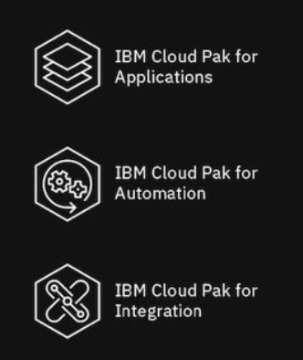

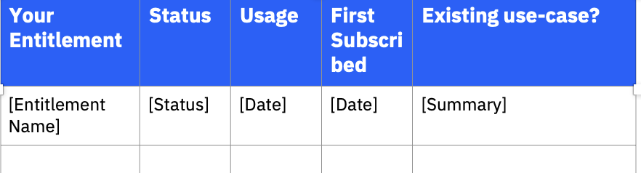
Brief summary / Quick Recap Customer Validation
Customer
Logo
1 - No engagement
2 - Internal engagement only
3 - Client & IBM engagement
4 - Hold your own meeting w/ client
5 - Trusted Advisor to Client
1- What do we know about customers?
Validate with customers our
understanding
CLOUD PAKS IN DEPLOYMENT FOCUS
CTL : Client Technical Lead
SCL: Software Client Lead
STA: Software Technical Architect
SDL: Software Deployment Lead
Business Strategy / Objectives – Requirements
Program priorities - related projects
Relationship between IBM and customer / partner
Hybrid Cloud Strategy and current Architecture
Use cases in focus
IBM Technology Level of adoption
IBM Point products in use or via Cloud Paks
OCP level of adoption – if applicable
….
3-Entitlements:
what’s in the box for them
- ready to consume ?
END OF SUPPORT PRODUCTS
2- Know customer pains,
understand current issues/ cases
Cloud Packs related ,
Escalations
4-Visibiity on EoS Products
in focus for your customer
IBM Customer Success / © 2022 IBM Corporation
Notes:
Licence point products for Business Automation – Trade up from DBA
Open : Buy CP4BA ?
Some of the information can be found in the scorecard we used couple of months ago (including the logo).
Feel free to copy the information and update it per the above template.
Scorecard location: https://ibm.box.com/s/w44sktn7n5aye7axp95x835a21jbaykq
ELA – You should check with you SCL for that info (if you don’t have it)
Key Infrastructure - CTL
Cloud paks table is basically the Heatmap
IBM Team - no need to list every person, just the key folks: Client exec, CTL, SCL, SCA and if there is anyone else key to that customer e.g. PeP exec?
Bottom table, You may have that already and if not, you may get it from the CTS (Client Technology Strategy) ppt, ISAP (check with your CTL how to access them) or 10-K Filing of the customer

Slide 6
Current Initiatives & Goals YY++
Customer
Logo
Initiatives |  | Tactics Actions steps | Prio | Business Impact Expected Outcomes | IBM Enablers Cloud Paks | Outlook / Status
1
2
NOTE
BUSINESS LED
ALIGNMENT ON IMPACT OF
CSM
ENGAGEMENT ACTIVITIES
Based on account planning info
IBM Customer Success / © 2022 IBM Corporation
Notes:
Licence point products for Business Automation – Trade up from DBA
Open : Buy CP4BA ?
Some of the information can be found in the scorecard we used couple of months ago (including the logo).
Feel free to copy the information and update it per the above template.
Scorecard location: https://ibm.box.com/s/w44sktn7n5aye7axp95x835a21jbaykq
ELA – You should check with you SCL for that info (if you don’t have it)
Key Infrastructure - CTL
Cloud paks table is basically the Heatmap
IBM Team - no need to list every person, just the key folks: Client exec, CTL, SCL, SCA and if there is anyone else key to that customer e.g. PeP exec?
Bottom table, You may have that already and if not, you may get it from the CTS (Client Technology Strategy) ppt, ISAP (check with your CTL how to access them) or 10-K Filing of the customer

Slide 7

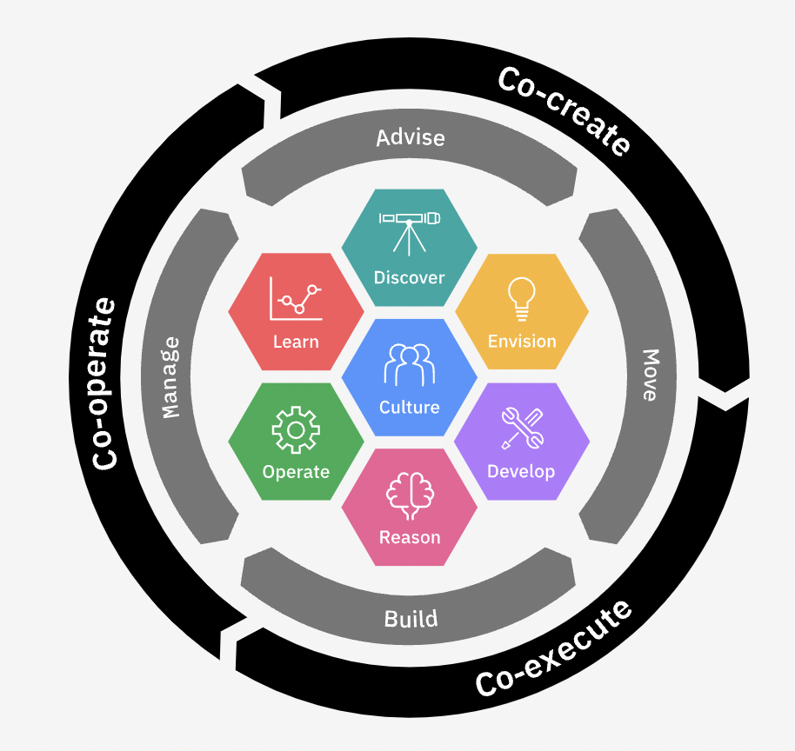
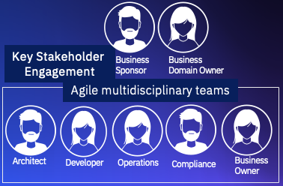
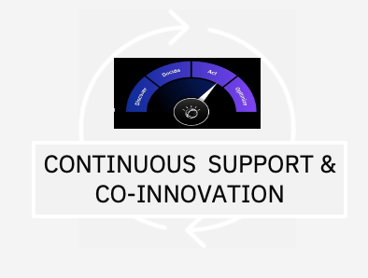

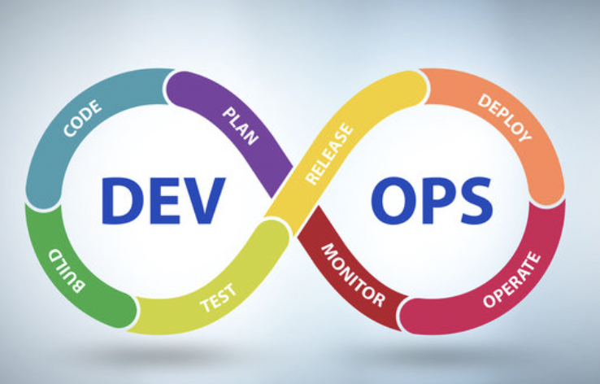


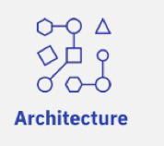
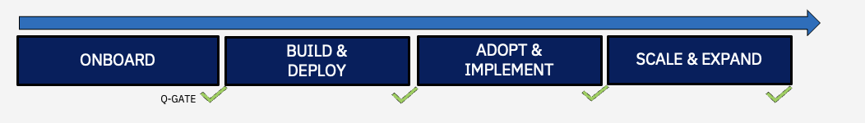
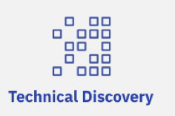

Timeline in this deck
subject to change
based on
Customer Confirming Scope
Customer
Logo
High Level Roadmap Proposal
YEAR
Q1
Q2
Q3
Q4
+++
INITIATIVE 1
INITIATIVE 2
…..
INITIATIVES STATUS
IN EVALUATION
CSM
FUNDING PENDING
PROJECT USE CASES
Use Case 1
APPROVED
IN PROGRESS
Use Case 2
EXECUTED
Use Case ….
CONTINUOUS INVESTMENT WITH IBM CUSTOMER SUCCSS
CO-INNOVATE AND ACCELERATE TIME TO VALUE WITH RAPID DEPLOYMENT
Group Name / DOC ID / Month XX, 2020 / © 2020 IBM Corporation

Slide 8

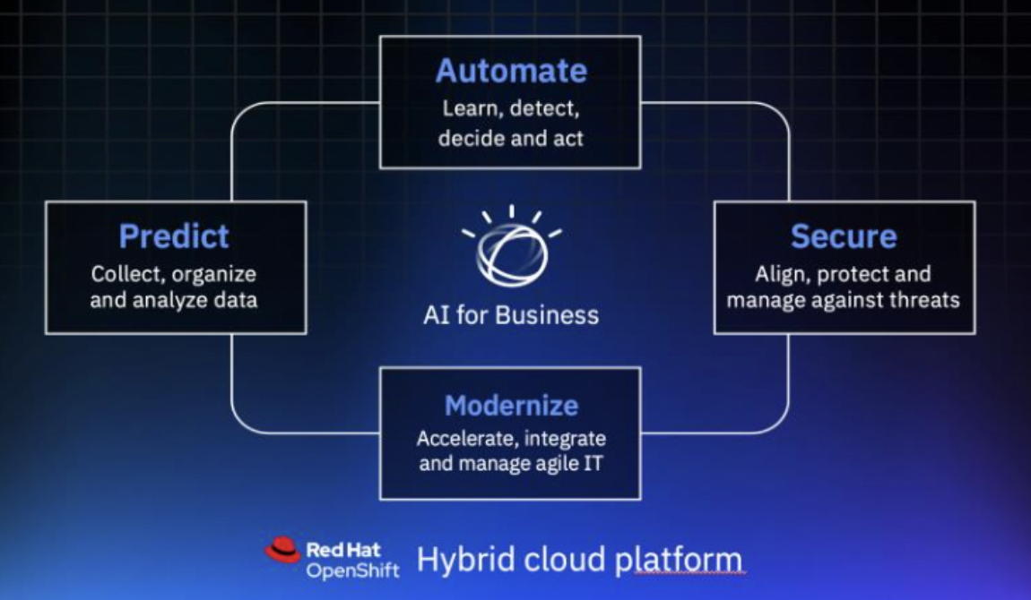

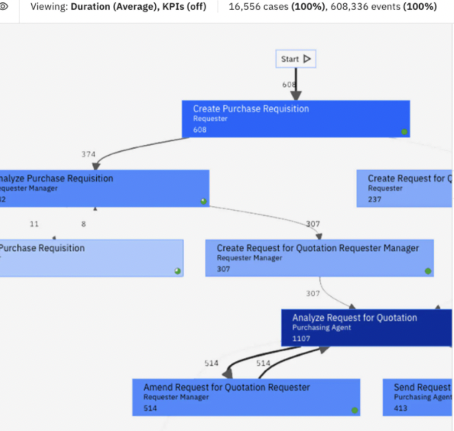

Our Possible Hybrid Cloud Journey
STRATEGIC ENGAGEMENT – CO-INNOVATION & CONTINUOUS CONTROL
Combine operational models with AI driven insights – enabling and strategic actions
Build native cloud applications - Enrich CX with low code and smart apps
Real-time Data & Analytics / Measurement of success
Innovate
AGILITY & INTELLIGENT ENTERPRISE
Accelerate time to value with automation of end-to-end business processes and infusing AI
Scale business needs and choose the right deployment model
Continuously improve operational performance
Identify opportunities for containerization and move workloads to cloud
Modernize
ENTERPRISE GRADE CONTAINER PLATFORM
Open, fast and secure way to build once, move and run business application anywhere
End-user experience monitoring,
Intelligent IT operations
Enablement
ACCELERATING DIGITAL TRANSFORMATION
OUR DIFFERENT LEVELS OF ENGAGEMENT
Commercial in Confidence
8
Group Name / DOC ID / Month XX, 2020 / © 2020 IBM Corporation

Slide 9



<use case name>
Customer
Logo
Use Case Summary < including background information / business impact – resonance to related Initiatives > | Challenges < inhibitors, risks,..>
Target Users < end users>
Expected Outcome/ Benefits < summary of benefits Quantitative Qualitative > | IBM Technology Enablement < Technical Approach>
Measurement of Success <KPIs, …>
NOTE
TECH LED
WITH BUSINESS IMPACT
INITIATIVE 1
Notes:
Licence point products for Business Automation – Trade up from DBA
Open : Buy CP4BA ?
Some of the information can be found in the scorecard we used couple of months ago (including the logo).
Feel free to copy the information and update it per the above template.
Scorecard location: https://ibm.box.com/s/w44sktn7n5aye7axp95x835a21jbaykq
ELA – You should check with you SCL for that info (if you don’t have it)
Key Infrastructure - CTL
Cloud paks table is basically the Heatmap
IBM Team - no need to list every person, just the key folks: Client exec, CTL, SCL, SCA and if there is anyone else key to that customer e.g. PeP exec?
Bottom table, You may have that already and if not, you may get it from the CTS (Client Technology Strategy) ppt, ISAP (check with your CTL how to access them) or 10-K Filing of the customer

Slide 10
Timeline in this Deck subject to change based on
<customer> confirming Scope
Customer
Logo
Use Case Lifecycle
Accelerating Hybrid Cloud & AI
Client
Journey
Stages
Plan
Determine the vision and prepare for the future
Prove
Prepare, test, and iterate for developing solution success
Adopt
Deploy solutions and begin to see real business value
Scale
Distribute success across organization
Business
value
Gate: Success Review
Success Measurement
Improvement opportunities
Gate: GO/NO GO
Strategic Deployment
Upskill
Employees
Consult
Experts
Use Case
Development
Integrate &
Operationalize
MVP
Detailed
Analysis
Present findings &
Agree on Formal Plan
Benefit
Case
Client Engineering
Expert Labs
High Level
Plan
Key
Milestone
Solution
Maturity
Continual investment with IBM CSM
Notes:
This is the high level plan for how to help client deliver migration
Action Plan
Step 0:Option : Gather customer business information about build a value proposal/ benefit case for server optimization potentials with containerization of the on-prem
Step 2: Creation of high level plan (based on findings from information gathering phase)
Step 3:
Run Process Mining on selected business applications are identify areas of improvement (sponsorship) -→ We know business processes to improve
Run Transfornation Advisor scan / on a small group of selected candidate business applications (sponsorship for this phase is essential) → We assess path for migrations
Step 4:IBM to invest in MVP to showcase modernization using a candidate business app and findings from TA scan.
Step 5: IBM to present findings of MVP to key sponsors and agree on formal plan with client.
**
For MVP
**
Identify apps that represent different architecture patterns that they deploy –
Simple, medium, complex – topology info – and we will scan 1 instance of each of the 3 types
Could even be narrowed down by importance -

Slide 11

Customer
Logo
Our Next Steps | Actions by CSM
Consolidate High-Level Engagement Plan based on the outcome of this session and share with stakeholders
Identify/ consolidate and validate use cases for initiatives in focus according to agreed priorities
CSM onboarding and commitment to customer’s deployment success | active participation in governance and projects meeting
Include and follow-up on any other points agreed during Scoping Session
Notes:
We know already a bit a out you

Slide 12
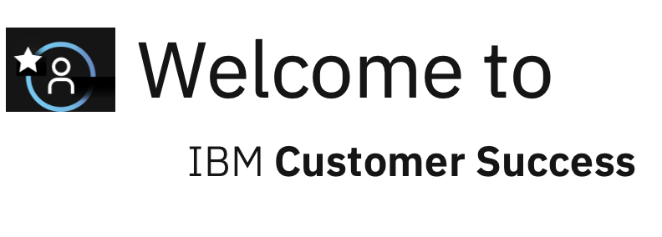

Thank You!
Name Surname
Customer Success Manager
E-mail:
M:
LinkedIn Profile
Add your details

Slide 13
Appendix
CSM Use cases references/quotes & Customer Success Stories
CSM onboarding & communication framework
Entitlements
Cases/Issues overview
CSM Engagement Model
Notes:
We know already a bit a out you

Slide 14

Next Steps | CSM Onboarding
Customer
Logo
1 - No engagement
2 - Internal engagement only
3 - Client & IBM engagement
4 - Hold your own meeting w/ client
5 - Trusted Advisor to Client
Meeting | Frequency | Date
Governance Meeting | [Monthly] | [TBC]
Project [1] Meeting | [Weekly, Fortnightly] | [TBC]
Project […] Meeting | [Weekly, Fortnightly] | [TBC]
CTL : Client Technical Lead
SCL: Software Client Lead
STA: Software Technical Architect
SDL: Software Deployment Lead
IBM Customer Success / © 2022 IBM Corporation
Notes:
Licence point products for Business Automation – Trade up from DBA
Open : Buy CP4BA ?
Some of the information can be found in the scorecard we used couple of months ago (including the logo).
Feel free to copy the information and update it per the above template.
Scorecard location: https://ibm.box.com/s/w44sktn7n5aye7axp95x835a21jbaykq
ELA – You should check with you SCL for that info (if you don’t have it)
Key Infrastructure - CTL
Cloud paks table is basically the Heatmap
IBM Team - no need to list every person, just the key folks: Client exec, CTL, SCL, SCA and if there is anyone else key to that customer e.g. PeP exec?
Bottom table, You may have that already and if not, you may get it from the CTS (Client Technology Strategy) ppt, ISAP (check with your CTL how to access them) or 10-K Filing of the customer

Slide 15
Customer
Logo
Scope | Your current IBM entitlements
Your Entitlement | Status | Usage | First Subscribed | Existing use-case?
[Entitlement Name] | [Status] | [Date] | [Date] | [Summary]
Note to CSMer
Fill this in or paste a screenshot from Fastpass
Alignment with ELA/ TDL
Date DD/MM/YY
Notes:
We know already a bit a out you

Slide 16
Your current IBM entitlements
Note to CSMer
Pre-fill this with what you know and then update with the customer.
Goals:
What do you want to achieve with your IBM entitlements?
Working well:
What's working well with your entitlements?
[Fill in with what you know about the customer’s goals.]
Goal
Goal
Goal
+
+
+
+
Goal
Goal
Goal
Goal
+
+
+
+
Goal
Goal
Goal
Goal
+
+
+
+
Notes:
We know already a bit a out you

Slide 17
Your current IBM entitlements
Consolidate the
Enablement
Plan (Next steps)
Not the focus of the meeting
Outlook !
Note to CSMer
Pre-fill this with what you know and then update with the customer.
Not working well:
What challenges are you having with your entitlements?
IBM Help:
How can IBM help you with your challenges? (Use suggestions from the IBM CSM Tool Kit as needed.)
-
-
-
-
Co-create solutions to accelerate time to value
Conduct a Framing Workshop to explore additional opportunities
Conduct a Technical Discovery Workshop
Conduct a Modernization Workshop
-
-
-
-
Provide demonstrations to your team
Validate architecture design
Knowledge transfer / best practices
Option to help
-
-
-
-
Option to help
Option to help
Option to help
Option to help
Notes:
We know already a bit a out you

Slide 18




Cases Overview | Action Plan Background Info
Customer
Logo
1 - No engagement
2 - Internal engagement only
3 - Client & IBM engagement
4 - Hold your own meeting w/ client
5 - Trusted Advisor to Client
Access to case view for update
On cases related to CSM deployment
Actvitiies
CTL : Client Technical Lead
SCL: Software Client Lead
STA: Software Technical Architect
SDL: Software Deployment Lead
OVERVIEW | CASES MANAGEMENT | SCOPE: CLOUD PACKS OPERATIONS
Issue # | Prio-Severity | Issue Summary | Status | Date Created | Last Update
DETAILS | CASE RESOUTION | ACTION PLAN
Issue Description | Prio - Severity | Business Impact | Status – Date DD/MM/YY
Action Plan | Risks
… … …
NEXT STEPS
Notes:
Licence point products for Business Automation – Trade up from DBA
Open : Buy CP4BA ?
Some of the information can be found in the scorecard we used couple of months ago (including the logo).
Feel free to copy the information and update it per the above template.
Scorecard location: https://ibm.box.com/s/w44sktn7n5aye7axp95x835a21jbaykq
ELA – You should check with you SCL for that info (if you don’t have it)
Key Infrastructure - CTL
Cloud paks table is basically the Heatmap
IBM Team - no need to list every person, just the key folks: Client exec, CTL, SCL, SCA and if there is anyone else key to that customer e.g. PeP exec?
Bottom table, You may have that already and if not, you may get it from the CTS (Client Technology Strategy) ppt, ISAP (check with your CTL how to access them) or 10-K Filing of the customer

Slide 19
Next steps
Note to CSMer
Capture next steps to work with the customer here.
Steps | Owner | Estimated deadline
[Step] | [Owner] | [Estimated deadline]
Notes:
We know already a bit a out you

Slide 20
Opportunity Statement
A more detailed exploration of the use case, related to the opportunity, that concretely describes the system or experience to impact and the people who will benefit from the outcome.
CS Framing Session
Example Activities
Your Business Landscape
Quickly outline your goals and challenges.
Opportunity Statement
A more detailed exploration of the use case related to the opportunity that concretely describes the experience to create or improve and the people who will benefit from the outcome or be impacted by it.
Explore opportunities to get the most value from your IBM subscription.
4 hours, no-charge, focused on business value
Delivered virtually through video conference, in 1 or more session
Opportunity Alignment
Identify IBM capabilities that can help you with your challenges and bring you closer to your goal.
What to Expect
Your team is guided through series of collaborative activities to explore your business goals and align them to the challenges that block or slow you down. IBM experts work with you to uncover and describe opportunities as concrete use cases focused on the people who require the outcomes and the experiences that need to change.
Your team prioritises the opportunities that you would like to explore further with IBM.
You Gain
Clarity on opportunities to address your goals and challenges and advice how your IBM solutions can help
Use case descriptions that align your goal to your challenge, the process, and people that need to be impacted in order for you to achieve your goal
A focused starting point to collaborate with IBM to and ensure that you get real value from your IBM investment
Stakeholder alignment on prioritized goals and challenges
Challenge
Capability
We have a problem/challenge:
The impact on our business/team is:
We know we have a problem, because we can see/hear
The people and processes we need to impact:
We would like to explore the opportunities provided by:
If we address the challenge, we expect to see:
Goal
Challenge
Challenge
Capability
Challenge
Capability
Goal
Why we must address this
Challenge
Capability
Goal
Challenge
Visible or Measurable Evidence we must impact with change
Opportunity Prioritization
Focus in on the opportunities to advance that will deliver the most value for your team or department.
People
Processes
Opportunity
Opportunity
Capability
Challenge
Challenge
Capability
Capability
1
3
Goal
Goal
2
Business Value
Quantifiable or Qualifiable Evidence of Progress toward the Goal
Goal
Challenge
Evidence
Capability
Roles, Processes and Systems
Proof
Opportunity
You have goals for your business.
Challenges stand in the way.
You have evidence that the challenge needs to be addressed.
Together we explore ideas for how to address your challenges.
We highlight the roles, processes and systems that will be impacted by the change you envision.
We describe the impact to be measured.
Challenge
Capability
Opportunity
Goal
Challenge
Capability
Goal
Speed to Deliver

Slide 21
Your IBM team
Note to CSMer
Fill these in for your client.
[Your Name]
Customer Success Manager for [Client]
[Your Email]
I am here as a point of contact for IBM. Please reach out to me with concerns or questions at any time.
[Name]
IBM Client Executive
Email Number
[Name]
Client Sales Rep
Email Number
[Name]
IBM Support Email Number
[Name]
IBM Cloud Billing (only if not IBM Cloud) Email Number
[Name]
Feedback to Offering Management
Email Number
[Name]
Manager of CSMs
Email Number

Slide 22
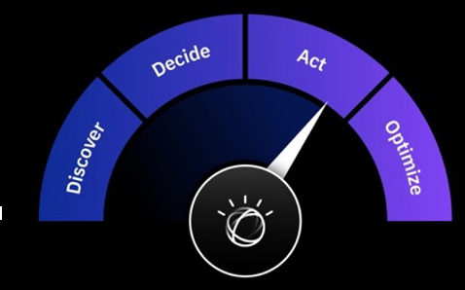

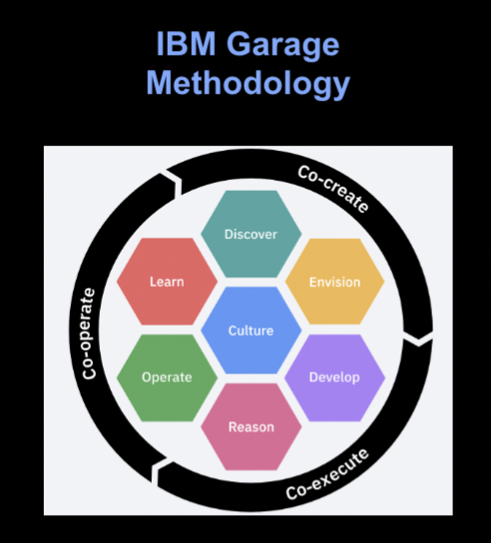

Customer
Logo
Our Engagement Model
ONBOARD
BUILD &
DEPLOY
ADOPT &
IMPLEMENT
SCALE & EXPAND
Q-GATE
CONTINUOUS SUPPORT & CO-INNOVATION
Outcomes
Understanding of your pain points/ challenges and business objectives
List of use cases and prioritization
Definition of success criteria
Outcomes
MVP Architecture
Sign-off for MVP Build
System readiness
Running MVP
Outcomes
Production Architecture
Production Workload
Measurement against MVP
Outcomes
Identification of additionnal deployments opportunities
Qualification of new use cases
Outcomes
Reporting & measurement of success
Demonstration of value out of IBM Cloud Pak offerings
Identification of new use cases enabling s strategic initiatives
Expert Labs
Deployment Architects
Offering Management
IBM Best Practices
(Tech) Sales /
Client Engineering
Support
Notes:
We know already a bit a out you

Slide 23
CSM Engagement | ASEANZK Strategic Initiatives
Add
Consolidated CSM Strategic Engagement Initiatives
In ref. CSM Use Cases in resonance with Customer
Industry
Entitlements / IBM Technology & Cloud Paks
E.g.:
Government, Banking, Insurance
Data AI, Automation, Modernization to Cloud-native architecture,..
Notes:
We know already a bit a out you

Slide 24
CSM Engagement | Customer Success
Add
Customer Success Stories in resonance with Customer’s one
Industry
IBM technology / solutions
Notes:
We know already a bit a out you

Slide 25
CSM Engagement | A proven key to Success
Add
Dedicated CSM Spotlight Stories in resonance with Customer
Industry
IBM technology / solutions
Notes:
We know already a bit a out you

